Slide 1
Chapter 4 Induction and Recursion

Slide 2
Recursion - Objectives
Recursive definitions
Sequences, functions
Sets
Recursive Algorithms
Fibonacci numbers
Binary search
Merge sort
More exercises (optional)

Slide 3
Recursion - Introduction
Fibonacci numbers: 1, 1, 2, 3, 5, 8, 13, 21, 34, …
n 1 2 3 4 5 6 7
F_{n} 1 1 2 3 5 8 13
F₈ = ?
F₂₀ = ?
F₁₉ = 4181
F₁₈ = 2584
F₂₀ = F₁₉ + F₁₈ = 6765

Slide 4
Recursive definition of Fibonacci numbers
procedure fibo(n: positive integer)
if n=1 or n = 2
return 1
else
return fibo(n-1) + fibo(n-2)
basis step
F₁ = 1, F₂ = 1
recursive step
F_{n} = F_{n-1} + F_{n-2}, for n > 2
recursively

Slide 5
Recursive definition
a[n] = 5n – 2, n = 1, 2, 3, …
a[1] = ?
a[10] = ?
Recursive:
compute a[n] from a[n-1]

Slide 6
Recursive definition for a[n] = 5n – 2, n = 1, 2, 3, …
a[n] = 5n – 2
a[n-1] = 5(n-1) – 2 = 5n – 7
Try to find a rule for computing a[n] from a[n-1]
a[n] = a[n-1] + 5 if n > 1 # recursive step
a[1] = 3 # basis step

Slide 7
Recursive algorithm
a[1] = 3 if n = 1
a[n] = a[n-1] + 5 if n > 1
procedure tinh(n: positive integer)
if n=1
return 3
else
return tinh(n-1) + 5
recursively

Slide 8
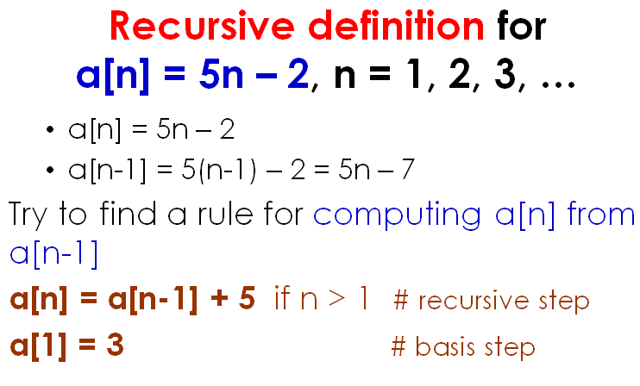
Do yourself
Find a recursive definition of the function/sequence:
1. a[n] = a_{n} = n, n =1, 2, 3, …
2. f[n] = f(n) = 1 + 2 + 3 + … + n, n = 1, 2, 3, …

Slide 9
f(n) = 1 + 2 + 3 + … + n, n = 1, 2,
f(n) = 1+2 + … + (n-1) + n
f(n-1) = 1+2 + … + (n-1)
f(n) = f(n-1) + n, if n > 1
and f(1) = 1

Slide 10
procedure tinhf(n: positive integer)
if n = 1
return 1
else
return tinhf(n-1) + n
What is the result after calling tinhf(5)?

Slide 11
procedure thuattoan(a: real number, n: non-negative integer)
if n = 0
return 1
else
return a*thuattoan(a,n-1)
What is the result after calling thuattoan(2,3)?
Recursive definition of a^{n}
a^{n} = 1 if n = 0
a^{n} = a*a^{n-1} if n > 0

Slide 12
Binary search
procedure bs(x,a,id,ic)
if (id > ic)
return -1
else
im : = (id+ic) div 2
if (a[im] = x) then
return im
else if (x > a[im])
return bs(x,a,im+1,ic)
else
return bs(x,a,id,im-1)

Slide 13
Recursively Defined Sets and Structures
The set A is defined recursively by:
3 ∈ A
x ∈ A if x-3 ∈ A
A = {3, 6, 9, 12, 15, …}
procedure check(x: positive integer)
if (x=3)
return 'OK'
else if (x<3)
return 'Not OK'
else
return check(x-3)
Algorithm to check if a positive integer belongs to A

Slide 14
Sets and Structures
S is the set of bit strings defined recursively by
The string 10 ∈ S
String 1w0 ∈ S if string w ∈ S
What is S?
S = {10, 1100, 111000, …}

Slide 15
Do yourself
Define the sets recursively
B = {4, 12, 36, 108, …}
C = {1,1/3,1/9,1/27,…}
S = {100, 110000, 111000000, 111100000000, …}
Ex. A = {3, 6, 9, …}
3 ∈ A
x ∈ A ➔ x +3 ∈ A
Ex. S = {10, 1100, 111000, …}
10 ∈ S
w ∈ A ➔ 1w0 ∈ A

Slide 16
The merge sort - idea
mergesort(4,7,2,6,9,3,1,8,5)
4 7 2 6 9 3 1 8 5
mergesort(4,7,2,6) mergesort(9,3,1,8,5)
➔ return 2 4 6 7 ➔return 1 3 5 8 9
merge(2 4 6 7 and 1 3 5 8 9)
➔ return 1 2 3 4 5 6 7 8 9 sorted

Slide 17
4 7 2 8 9 3 1 6 5
4 7 2 8 9 3 1 6 5
4 7 2 8 9 3 1 6 5
4 7 2 8 9 3 1 6 5
6 5

Slide 18
6 5
4 7 2 8 9 3 1 5 6
4 7 2 8 3 9 1 5 6
2 4 7 8 1 3 5 6 9
1 2 3 4 5 6 7 8 9

Slide 19
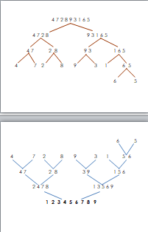
The Merge Sort Algorithm
procedure mergesort(L = a₁,...,a_{n})
if n> 1 then
m := floor(n/2)
L₁ := a₁,a₂,...,a_{m}
L₂ := a_{m+1},a_{m+2},...,a_{n}
L := merge(mergesort(L₁),mergesort(L₂))
{L is now sorted}
recursively
Time complexity: O(nlogn)

Slide 20
How to merge?
≤
L₁: L₂:
smallest of L₁ compares with smallest of L₂
L:
2
4
6
7
1
3
5
8
9
1< 2
2 < 3
3 < 4
4 < 5
5 < 6
6 < 8
7 < 8
≤

Slide 21
How to merge?
procedure merge(L1,L2: sorted lists)
L := empty list
while L1 and L2 are both nonempty
remove smaller of ﬁrst elements of L1
and L2 from its list; put it at the right end of
L
if one list is empty then
remove all elements from the other list and
append them to L
return L {merged}

Slide 22
pseudocode
procedure merge(l1, l2: increasing order)
n := length(l1) m := length(l2)
i := 1 j := 1 k := 1
while (i ≤ n & j ≤ m ) # both l1 and l2 are not empty
if (l1[i] < l2[j]) # compare
l[k] := l1[i] # remove the smaller one, put it in l[ ]
i := i+1 # update the smallest of l1
else
l[k] := l2[j] # remove the smaller one, put it in l[ ] j := j+1 # update the smallest of l2
k := k+1
while (i ≤ n ) # if l1 is not empty,
l[k] := l1[i] # append all elements of l1 to l[ ]
i := i+1 k := k+1
while (j ≤ m) # if l2 is not empty,
l[k] := l2[j] # append all elements of l2 to l[ ]
j := j+1 k := k+1
return(l) {l is the final sorted list}
O(n+m)

Slide 23
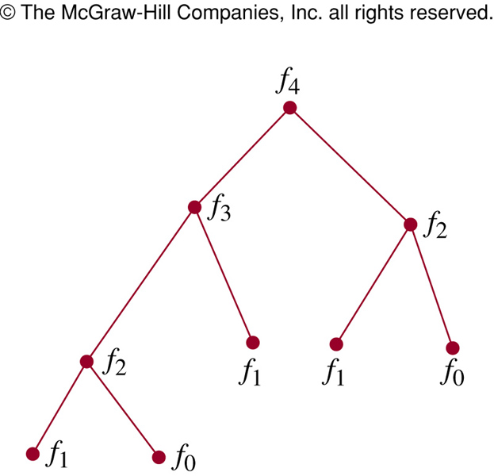
Recursion and Iteration
procedure rfibo (n: nonnegative integer)
if n=0 then rFibo(0)=0
else if n=1 then rFibo(1)=1
else rFibo(n) := rFibo(n-2) + rFibo(n-1)
procedure iFibo (n: nonnegative integer)
if n=0 then y:=0
else if n=1 then y:=1
else
x:=0 ; y:=1
for i:= 2 to n
z:= x+y
x:= y
y:=z
return(z)
{ iFibo(n) = z}
Recursive algorithm uses far more computation than iterative one
Notes:
To find the Fibonacci f_{n}, the recursive algorithm this algorithm requires f_{n+1} -1 additions.
Only n -1 additions have been used to find f_{n} with the iterative approach.

Slide 24

Induction - idea
How to arrange dominos?

Slide 25
p[1] = True
for k:=1 to 10 do
if (p[k] = True) then
p[k+1] = True
print p

Slide 26
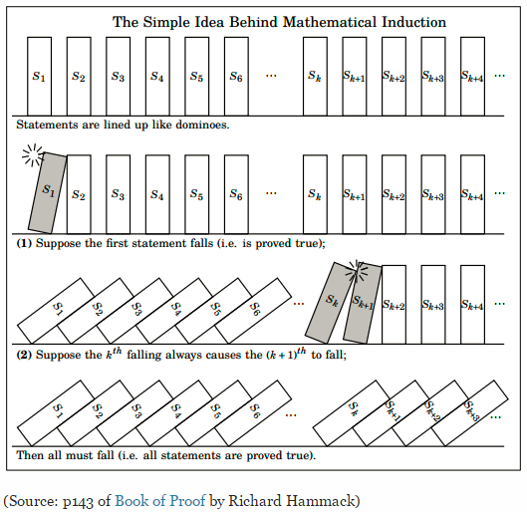
Mathematical Induction
Domino Arrangement and Mathematical Induction

Slide 27
Mathematical Induction
Basis step. Verify that P(1) is true
Inductive step.
Prove that P(k) → P(k+1) is true for all k ≥ 1
Prove that "n² + n is an even“ is true for every integer n > 0.
(1) Suppose for every integer k > 0, k² + k is even
(2) 1² + 1 = 2 is even
Make a correct order!
(3) Therefore, the statement is true.
(4) We have,
(k+1)² + (k+1) = k² + 2k + 1 + k + 1
= k² + k + 2(k+1).
This sum is even.

Slide 28
Induction: Example 1
Prove that 1 + 2 + 3+ …+ n = n(n+1)/2 for all integers n>0
Basis step:
Inductive step: With arbitrary k > 0, suppose
is true.
So
1+2+3+…+k+(k+1)
= (k+1)(k+2)/2
Proved.
the smallest value of n (n=1)
easy
?
“1 = 1(1+1)/2” ➔ true
P(1) is true
?
easy
“ 1+ 2+…+ k = k(k+1)/2”
P(k)
Do some math skills
= k(k+1)/2 + (k+1)
?
= [k(k+1)+ 2(k+1)]/2
P(k+1)
Notes:
Note that P(n) is entire equation, it is not only the left-hand side of the statement 1+2+3+…+ n = n(n+1)/2.

Slide 29
1/ Prove that 2n < n!, for integer n ≥ 4 using induction.
2/ Given the algorithm
procedure tinh(n : non-negative integer)
if (n = 0) return 1
else return n*tinh(n-1)
Using induction to prove that tinh(n) can be used for computing n! for n ≥ 0.

Slide 30
Summary
Recursive definitions
Sequences, functions
Sets
Recursive Algorithms
Fibonacci numbers
Binary search
Merge sort

Slide 31
THANKS

